Slide 1

GlobeSmart ProfileSM (GP)
Team Debriefing
Notes:
These slides may be used in their entirety for a Team Debrief situation, or may be used in portions to work with individuals or groups of individuals who do not form a team.

Slide 2
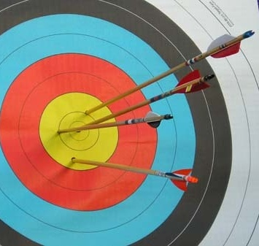
Objectives (Sample for Team Debriefing):
Understand Impact of Culture on Team Interactions
Know Yourself and Know Others
Identify and Bridge Gaps
Develop an Action Plan
Notes:
Image credit:
Target practice: © Proadventure (Licensed under Creative Commons 3.0)

Slide 3

Challenges for Working on a Global, Virtual Team
Language Barriers
Understanding Protocol
Time Zones and Distance
Problem Solving and Decision Making
Motivating; Creating a Sense of Urgency
Building Relationships Across Cultural Differences
Communicating Virtually
Leading a Virtual Team
Resolving Conflict
Notes:
Image credit: © Photosani/BigStockPhoto.com

Slide 4
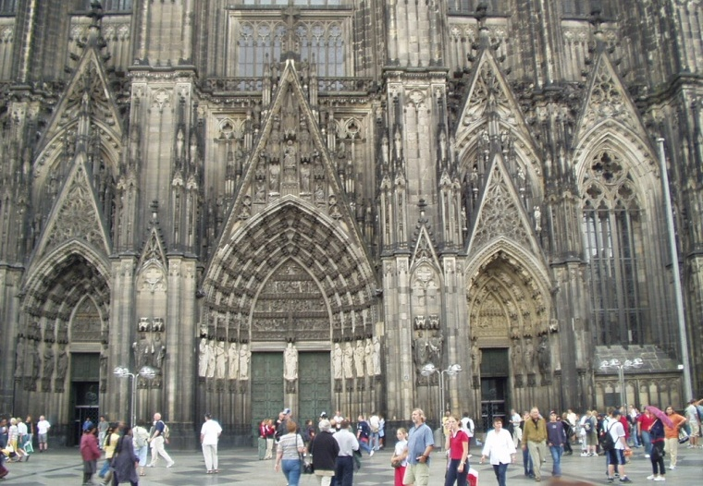
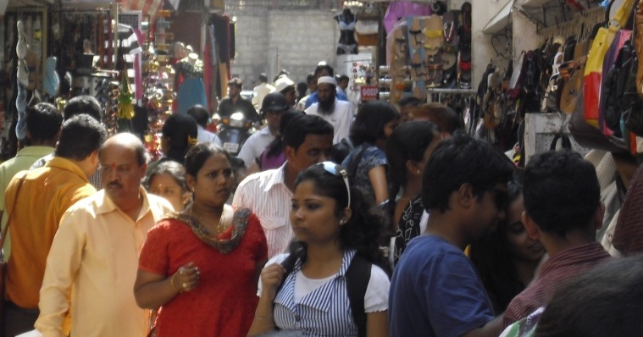
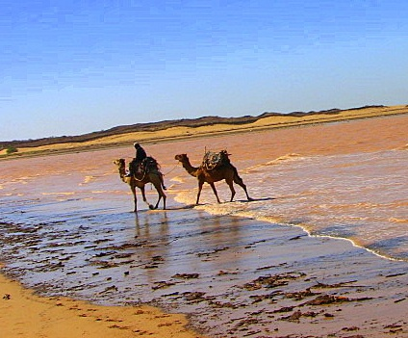
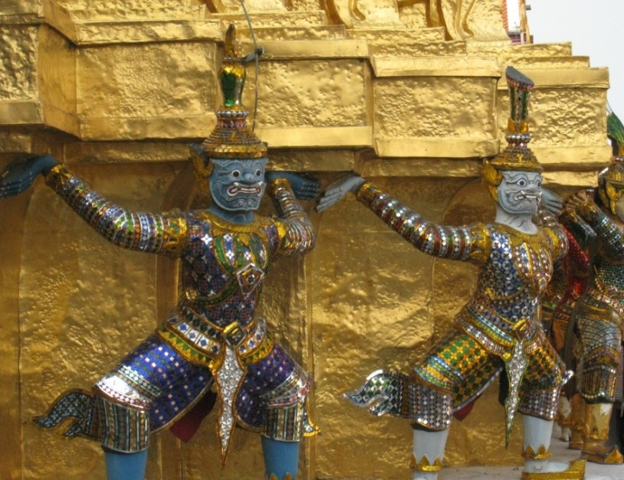
What is “Culture?”
(Culture) is the collective programming of the mind that distinguishes the members of one group…from another. Geert Hofstede, Cultures and Organizations
Culture hides more than it reveals, and strangely enough what it hides, it hides most effectively from its own participants. Edward T. Hall, The Silent Language
  What are examples of cultural differences you have seen between cultures?
Notes:
Image credits:
Thai temple detail: © Stephanie Fujii
Camels: © Christie Caldwell
Indian market: © Ernest Gundling
Cologne Cathedral: © Dave Dickey

Slide 5
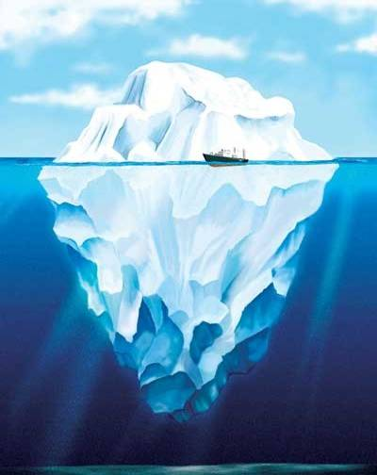


Lens of Culture
Culture A
Culture B
Visible
Visible
Dress
Food
Behavior
Language
Customs
Corporate Culture
History
Region
Assumptions
Beliefs
Family Values
Less Visible
Less Visible

Slide 6
Stereotypes & Generalizations
NEW INFORMATION
Most
Many
Often
Generally
Always
Never
All
Stereotypes
Generalizations
Fixed and oversimplified opinions, images or judgments
General statements, ideas or principles

Slide 7

Culture & Behaviors: Key Factors
Professional Specialty
Level of Experience
What Else?
Individual Style
Corporate Culture
National Culture

Slide 8
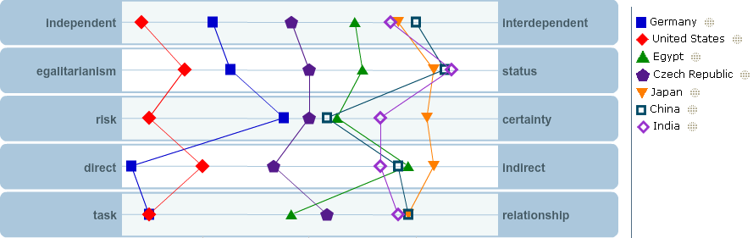
GlobeSmart® Cultural Dimensions
Aspects of culture that represent a range of work styles in a multicultural work environment

Slide 9
Information About the Sources for the Profiles
Country placements on the chart are estimates of entire cultures based on the best information that is available to us. Users should not assume that all people from a culture will be identical to the specific placement of their culture on the Profile chart. (The “bell curve” that appears when you select a country on the chart is a reminder that the country plots are simply averages; some people will be far to the left and some will be far to the right of the average plot for any given country.)
The country placements are a combination of the three data sets below:
  Merged data of four cross-cultural researchers: Hofstede, Schwartz, McCrae and Inglehart. We used the statistical averages of available country data on the cultural dimensions as they existed in the research literature from these researchers.
  GlobeSmart Profile User Data: We analyzed the data from 700,000 Profile users’ over the past several years, and combined this data with the data from the earlier research (mentioned above) to modify a number of the country placements. The users were from more than 70 countries.
  Expert anecdotal data: We then incorporated expert opinions from Aperian Global trainers and associates living and working in countries around the world to make final adjustments to the country placements.
Notes:
Notes:

Slide 10
How to Use the
GlobeSmart ProfileSM
You Your Colleague
YOUR GOAL!
Know the profile of you and your colleague in order to leverage similarities and bridge gaps
Dimensions are on a continuum
There is no “right” or “wrong” style
Profile result is not a predictor of success

Slide 11
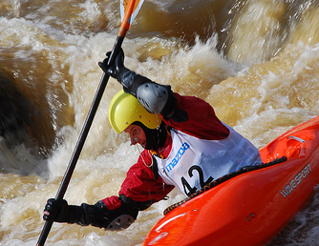
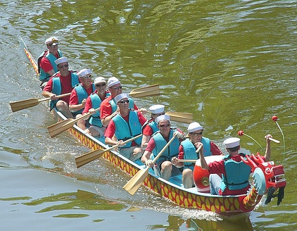
Key Dimensions of Culture:
Independent  Interdependent
How do I derive my identity?
Independent
Interdependent
Place great importance on individual identity
Derive identity from personal choices and achievements
Prefer taking action on one's own
Place great importance on group harmony and cooperation
Derive identity from group affiliation
Feel a sense of duty, obligation, and loyalty to ascribed groups
Notes:
Image credits:
Lone kayaker: © Vestman (Licensed under Creative Commons 3.0)
Crew team: © Onafly (Licensed under Creative Commons 3.0)

Slide 12
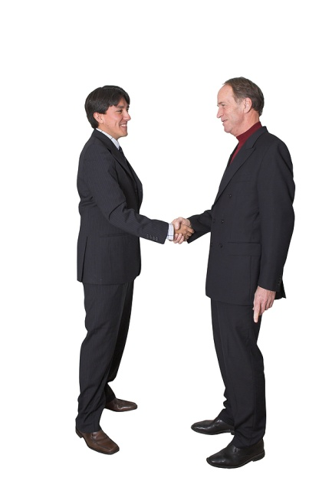
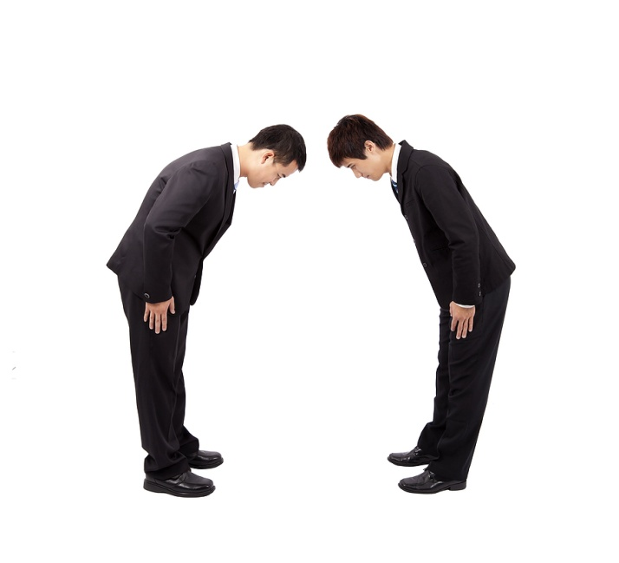
Key Dimensions of Culture:
Egalitarianism  Status
What is my preference for how my group should be structured and power should be distributed?
Egalitarianism
Status
Be comfortable challenging the views of superiors
Be flexible about roles
Treat everyone much the same
Assume power and authority should be shared broadly among a group
Prefer not to challenge those above them
Be deferential to superiors
Adapt behavior depending on relative status
Assume power and authority should be reserved for a few members of a group
Notes:
Image credits:
Men shaking hands: © Andres Rodriguez/BigStockPhoto.com
Men bowing: © Tom Wang/BigStockPhoto.com

Slide 13

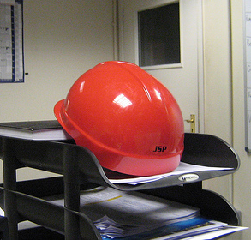
Key Dimensions of Culture:
Risk  Certainty
How do I make decisions in uncertain or ambiguous situations?
Risk
Certainty
Prefer rapid decision-making and quick results
Place great importance on flexibility and initiative
Value speed over thoroughness
Spend significant time on background research
Establish proper procedures before starting a project
Value thoroughness over speed
Notes:
Image credits:
Paraglider: © Oleg Klementiev. Licensed under Creative Commons 3.0
Hard hat: © Stephen Jones. Licensed under Creative Commons 3.0

Slide 14
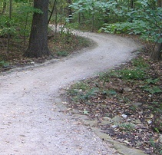
Key Dimensions of Culture:
Direct  Indirect
How do I communicate requests, tasks, and feedback?
Direct
Indirect
Come to the point quickly
Be forthright in asking questions in most settings
Be comfortable making requests, giving direction, or disagreeing with others
Give negative feedback directly
Spend time explaining the context before coming to the point
Avoid asking questions in public settings
Express disagreement in subtle ways
Give negative feedback indirectly
Notes:
Image credits:
Target practice: © Proadventure (Licensed under Creative Commons 3.0)
Winding path: © Erica Cherup (Licensed under Creative Commons. 3.0)

Slide 15


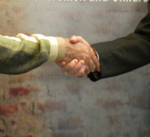
Key Dimensions of Culture:
Task  Relationship
When working on new projects, do I prefer to address tasks first, or relationships first?
Task
Relationship
Place high value on reaching goals and objectives on schedule
Prioritize accomplishing tasks over maintaining relationships
Focus on what people achieve more than who they know
View time building relationships as key to achieving good results
Prioritize maintaining relationships over accomplishing tasks on time
Focus on who people know as much as what they themselves can achieve
Notes:
Image credits:
Task-oriented businessmen: © Victor1558 (Licensed under Creative Commons 3.0)
Handshake: © U.S. Embassy New Delhi (Licensed under Creative Commons 3.0)

Slide 16
GlobeSmart® Team Profile

Slide 17

Profile Team Debrief
Questions for Team Discussion
What do you notice about your own GlobeSmart Profile?
What do you notice about the results of our team? Are there similarities? On which dimensions do we have a wider range of differences?
What are strategies we could use for bridging the style gaps?
How can team members best work together to ensure that the contributions of team members with different styles are fully incorporated?
Please prepare a report-out of Action Steps for your team to take.
Notes:
17
Other questions could be:
What is the impact of the Team Leader profile?
How can we leverage the similarities in our styles?

