Slide 1

GlobeSmart® Profile
Certification

Slide 2
Overview of Session
Introductions & Overview
Participant Practice
Team Profile Debrief & Practice
Questions & Answers
Development Action Planning
Objectives:
Clearly explain the GlobeSmart dimensions of culture
Identify and utilize appropriate stories and examples to help bring the GlobeSmart dimensions to life in an engaging way
Effectively Facilitate a GlobeSmart Team Profile debrief
Respond to any questions or concerns that may be presented by participants of a debrief session

Slide 3
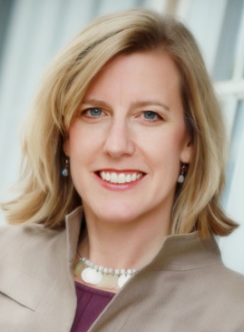
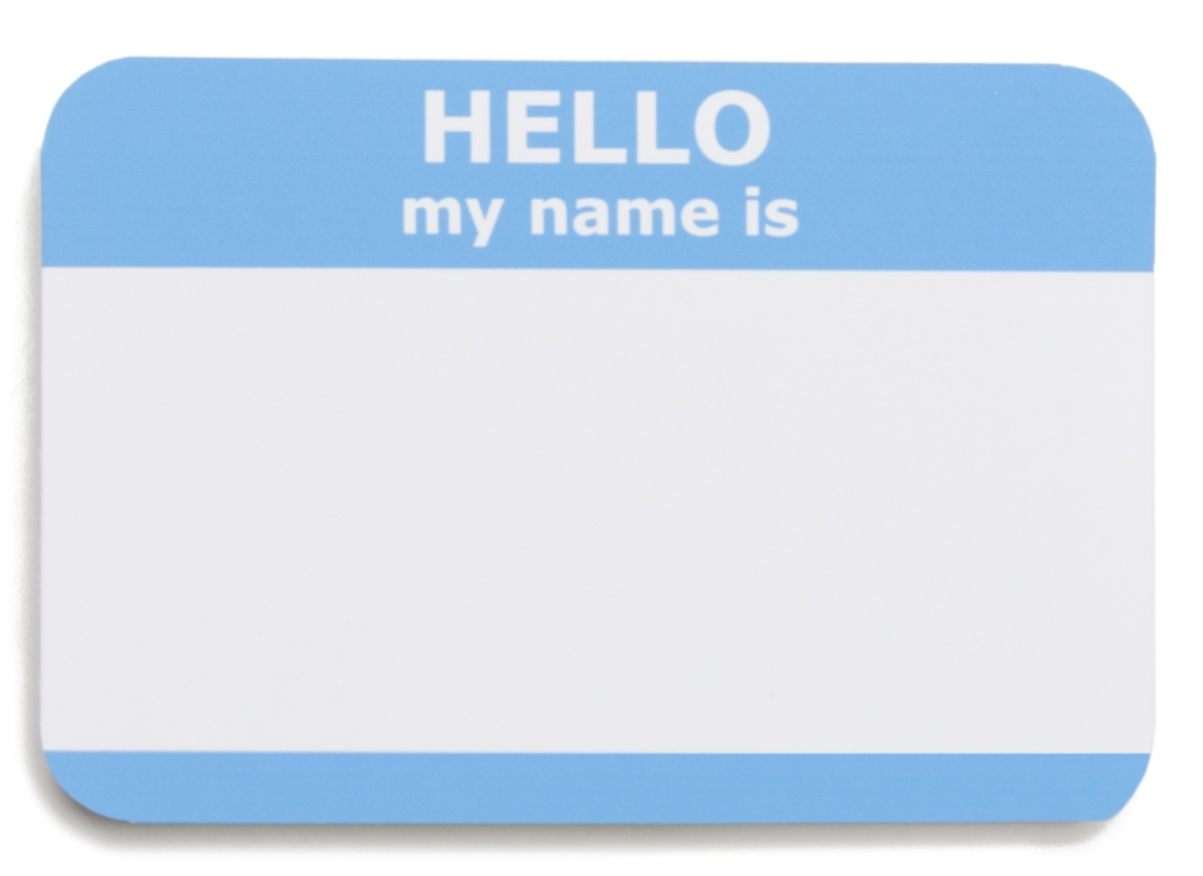
Introductions
Your Facilitator:
Lisa Kieffer Practice Group Leader
Update Pic / Name/Title
Briefly introduce yourself with:
Your Name / Work
What sort of training you anticipate using the GlobeSmart Profile with
Any particular questions for today
Notes:
Have them go around room and announce.
If larger group (5 or more), have them chat in their responses.

Slide 4

Working Agreements
No multitasking
Have a hard copy print-out of your GlobeSmart profile and your handouts
Have notepaper nearby to write down key learnings, instructions from facilitator or action items
Interactive Session (group discussion and hands-on portion)
Ask Questions (Chat, raise hand, or phone)
Other agreements?

Slide 5
Cultural Dimensions

Slide 6
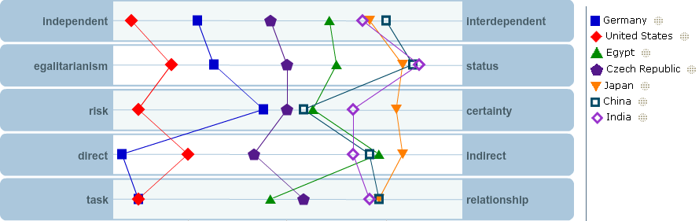
GlobeSmart® Cultural Dimensions
Aspects of culture that represent a range of work styles in a multicultural work environment

Slide 7

Practice Session
Utilizing story and/or an example, “teach” the dimension assigned to you, as you would in a training session.
After you finish, pause and consider how it went. Share your thoughts on your teachback.
Participants will also share their feedback with you.
The facilitator will then add final comments.

Slide 8
Team Profile Debrief Practice

Slide 9
Team Profile Debrief Process
Each participant will be assigned a unique team profile
Other participants should role play that this is your team’s profile
Please give an overall style analysis for the team
Choose the two dimensions you find most interesting for the team and debrief them
Answer questions from “team members” (other participants)
Receive feedback from participants & facilitator
Notes:
9

Slide 10
Team Profile 1

Slide 11

Profile Team Debrief:
Sample Discussion Points for Teams
  What do you notice about the results of our team? Are there similarities? On which dimensions do we have a wider range of differences?
  What are the potential strengths of our team? Potential challenges?
  What are strategies we could use for bridging the style gaps?
  How can team members best work together to ensure that the contributions of team members with different styles are fully incorporated?
  What is the impact of the team leader’s profile?
  Please prepare a report out of Action Steps for your team to take.

Slide 12
Team Profile 2

Slide 13
Team Profile 3

Slide 14
Questions & Answers

Slide 15
Q&A Brainstorm
  What questions do you anticipate arising during a team profile debrief? Each participant please share one question that you might anticipate.
  Another participant please volunteer an answer.
  Facilitator will give feedback.
  Write down any questions you want to have a “quick reference” to.

Slide 16
Developmental Action Planning

Slide 17

Development Action Planning
In the chat box:
Based on the feedback provided to you by the participants and facilitator, identify at least two things you can improve when discussing the cultural dimensions
Based on other participants’ presentations, identify at least one best practice you can adapt for your own use
Notes:
“must know” list
1. Know how to use and speak to GlobeSmart in training : make note that Line and Sonya will share practical examples during the hands on section and we welcome your best practices
For example: A participant in Working Globally program asks you how a business professional can benefit from using GlobeSmart, what do you say? Or
Expat needs to learn about establishing credibility in Brazil, what are the ways you can get there?
How can I use GlobeSmart as a global business professional?
2. How to use the GP Tool
Important: You have to Re-take the assessment Oct 3 or after
Know how to cover all the steps we will sahre in today’s demo, inviting users, viewing dimension description, etc.
A Project Manager wants to her team members to compare profiles. How do you show her and her team what to do and how to debrief it?
3. Encourage participants to make use of social media element of
And … Encourage the participant to engage with tool: questions, experience and adding media
4. Program you conduct may be part of a programmatic learning path
- You don’t need to do anything, just know that most core programs will eventually be linked to a learning path

Slide 18
GlobeSmart Team Profile
Prepare a list of the following for your personal use:
What question(s) would you ask a team during a team debrief?
What outcomes do you anticipate from these team debriefs?
How will you move them to taking action?

Slide 19
Recap & Closing

Slide 20

Recap of This First Session & Homework
Clearly explain the GlobeSmart dimensions of culture
Identify and utilize appropriate stories and examples to help bring the GlobeSmart dimensions to life in an engaging way
Effectively facilitate a GlobeSmart Team Profile
Respond to any questions or concerns that may be presented by participants of a debrief session
Your Homework:
Continue the Learning Path steps
  Access Code: UPDATE
Notes:
The enhancements = Doorway to a path in a garden of cross-cultural knowledge
Your role: Don’t need to be an expert in GS
Keeping alive and fresh in the training room
- Use best practices and share best practices
Reference the Facilitator GS 5.0 Checklist

Slide 21

About Aperian Global
We provide consulting, training and web tools for global talent development.
Aperian Global integrates Global Reach, Web Tools, and Thought Leadership in a way that provides uniquely compelling and innovative solutions for our clients’ globalization needs.
| www.aperianglobal.com
Global Leadership ▪ Global Teams ▪ Global Mobility
Global Diversity & Inclusion ▪ Global Business Skills
“
Our mission is to develop the capabilities of individuals,
teams, and organizations to perform effectively worldwide
in order to create a sustainable global future.
”
Notes:
We work with over 200 corporations, government agencies, and non-governmental organizations. Our clients represent a broad range of industries: computing, financial services, healthcare, information technology, management consulting, manufacturing, pharmaceuticals, and software.
Aperian Global has offices in Bangalore, Boston, Dubai, Kolding (Denmark), Paris, San Francisco, Shanghai, Singapore, and Tokyo. In addition to these locations, we have staff and associates on the ground in over 80 locations worldwide.

Slide 22
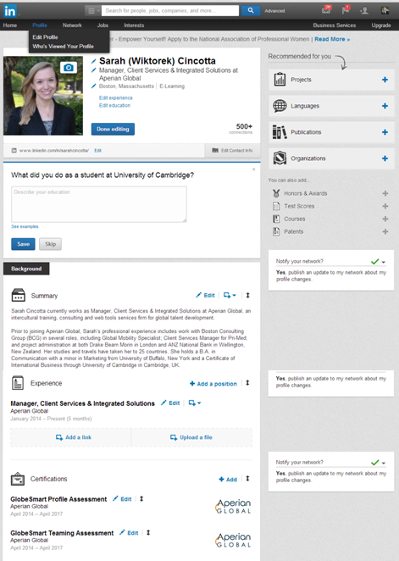
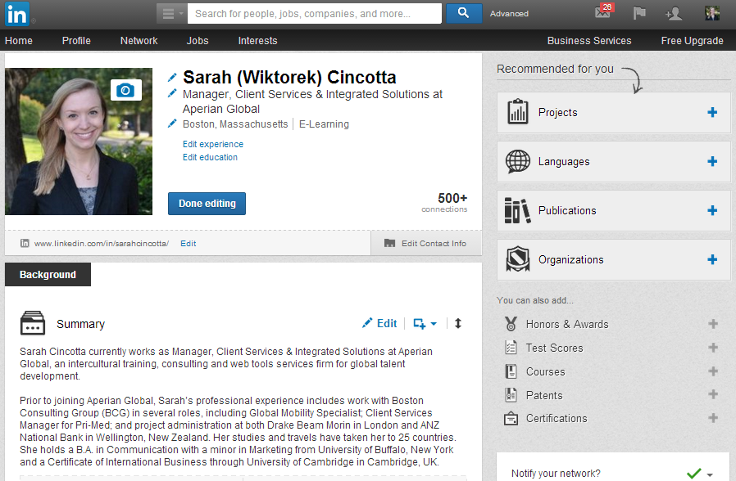
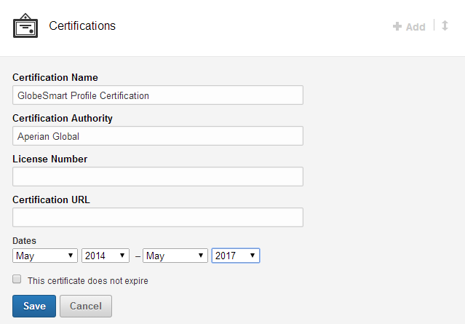
Adding Certifications to LinkedIn
After you’ve completed the Certification webinar, add your Certification(s) to your LinkedIn Profile.
1. Click on “Edit Profile”.
NOTE: If you have not yet added a certification, you will find the option to add a Certification on the right hand side menu.
2. Click “+Add” under the Certifications section.
3. Complete the Certification section.
List the full name of the appropriate Certification.
Certification Authority = Aperian Global
Start date = Month of certification webinar.
End date = 3 years later.

Slide 23
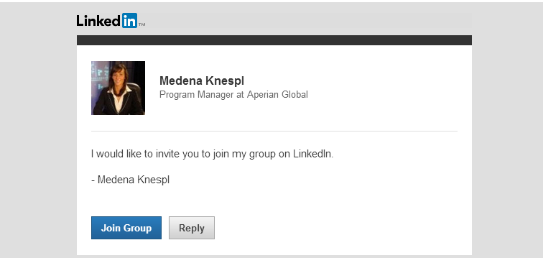
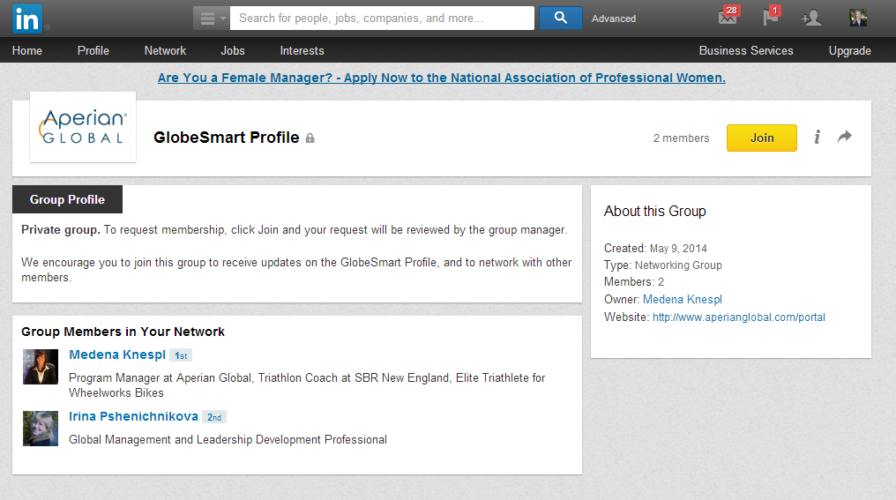
Join the Certification LinkedIn Group(s)
You will be invited to join our LinkedIn Group(s) dedicated to our various Certification programs. Join in to network with other Certified Consultants and stay updated on the latest tool enhancements!
After your certification, you will receive an email that looks similar to the one below.
Clicking on the “Join Group” link in your email will bring you into LinkedIn to join the group.

Slide 24
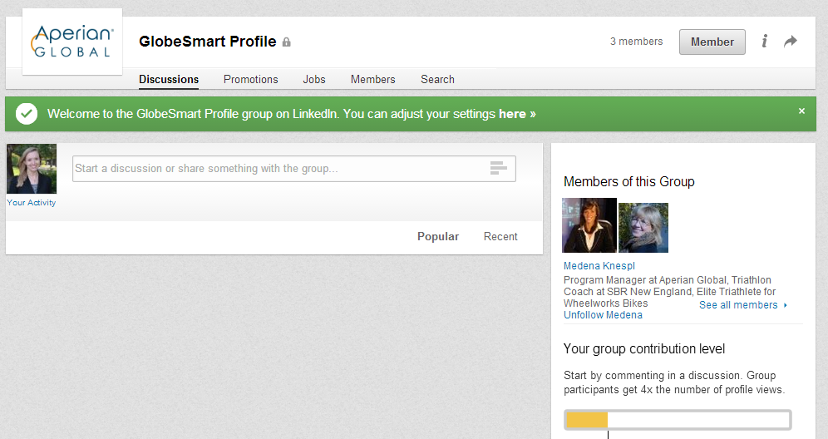
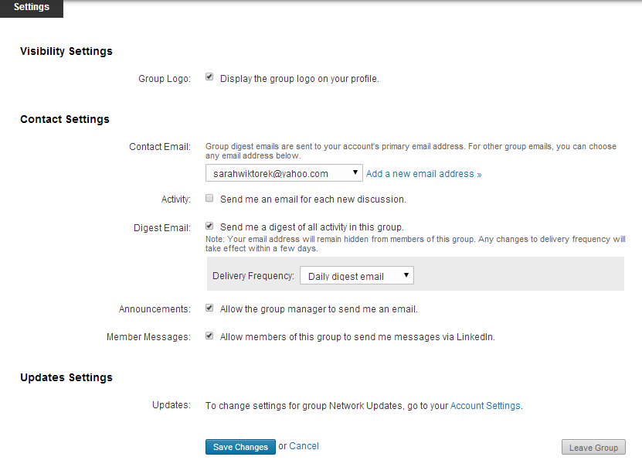
Adjusting LinkedIn Group Settings
We suggest adjusting your settings to “Send me a digest of all activity in this group” so you know when there is a new post.

Slide 25
Thank You
For more information contact:
Name, Title
emailaddress@aperianglobal.com
Direct 000.000.0000
Mobile 000.000.0000

Slide 26
Back-Up

Slide 27







How We View Each Other
A group of Mexicans and a group of Taiwanese were each asked to describe behaviors and traits of a U.S. American group
U.S. Americans are:
Rushed, time-conscious
Reserved
Realistic, hard-headed
Team player
Quality-conscious
Unemotional
Serious, business-like
Self-controlled
Group A
US Americans are:
Relaxed, easy-going
Friendly, outgoing
Optimistic
Independent
Output-oriented
Emotional
Fun-loving, joking
Self-indulgent
Group B
Adapted from Gary Wederspahn, The Bridge, Summer 1981

Slide 28


The Lens of Culture
Culture A
Culture B
Visible
Behaviors
Behaviors
Drives & Shapes Behaviors
Attitudes
Assumptions
Beliefs
Values
Attitudes
Assumptions
Beliefs
Values
Less Visible

Slide 29
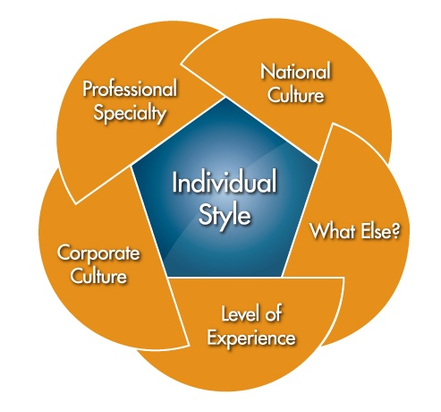
Key Factors For Our Behavior

Slide 30
How to Use the GlobeSmart® Profile
Your goal:
To know the profile of you and your colleague in order to leverage similarities and bridge gaps
You Your Colleague
Remember:
Dimensions are on a continuum
There is no “right” or “wrong” style
Profile result is not a predictor of success

Slide 31
Country Profiles Available on GlobeSmart
Information About the Sources for the Profiles
Country placements on the chart are estimates of entire cultures based on the best information that is available to us. Users should not assume that all people from a culture will be identical to the specific placement of their culture on the Profile chart. (The “bell curve” that appears when you select a country on the chart is a reminder that the country plots are simply averages; some people will be far to the left and some will be far to the right of the average plot for any given country.)
The country placements are a combination of the three data sets below:
  Merged data of four cross-cultural researchers: Hofstede, Schwartz, McCrae and Inglehart. We used the statistical averages of available country data on the cultural dimensions as they existed in the research literature from these researchers.
  GlobeSmart Profile User Data: We analyzed the data from 700,000 Profile users’ over the past several years, and combined this data with the data from the earlier research (mentioned above) to modify a number of the country placements. The users were from more than 70 countries.
  Expert anecdotal data: We then incorporated expert opinions from Aperian Global trainers and associates living and working in countries around the world to make final adjustments to the country placements.

Slide 32
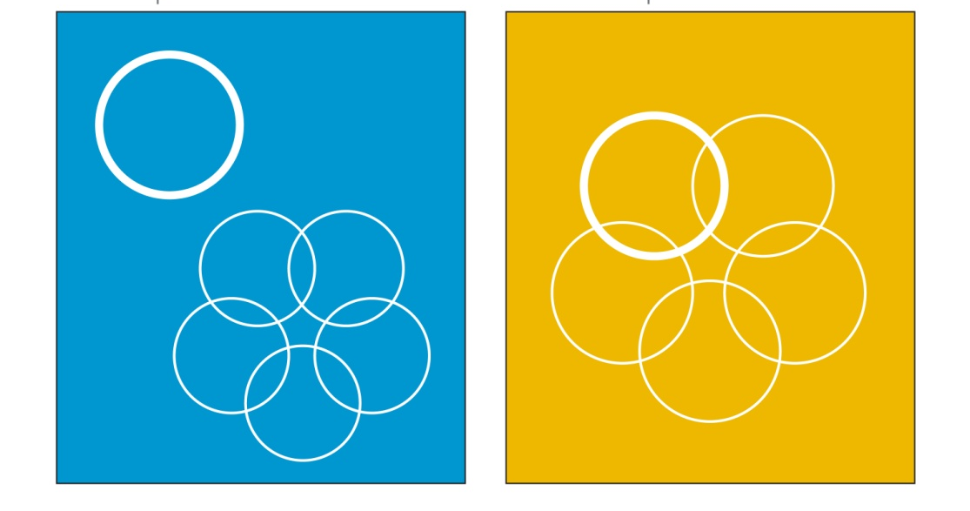
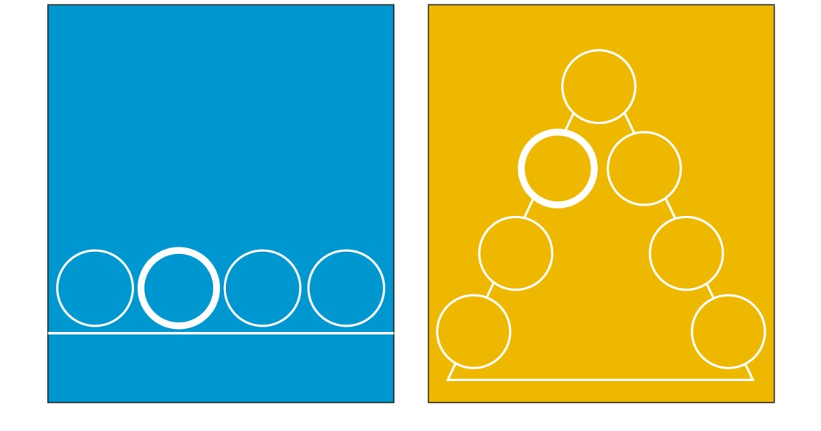
Key Dimensions of Culture
How do I derive my identity?
Independent
Place great importance on individual identity
Derive identity from personal choices and achievements
Prefer taking action on one's own
Interdependent
Place great importance on group harmony and cooperation
Derive identity from group affiliation
Feel a sense of duty, obligation, and loyalty to ascribed groups
What is my preference for how my group should be structured and power should be distributed?
Egalitarianism
Be comfortable challenging the views of superiors
Be flexible about roles
Treat everyone much the same
Assume power and authority should be shared broadly among a group
Status
Prefer not to challenge those above them
Be deferential to superiors
Adapt behavior depending on relative status
Assume power and authority should be reserved for a few members of a group

Slide 33
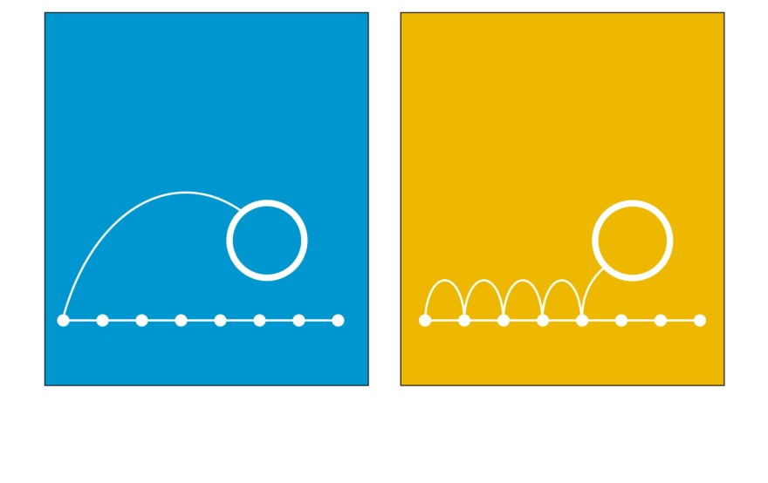
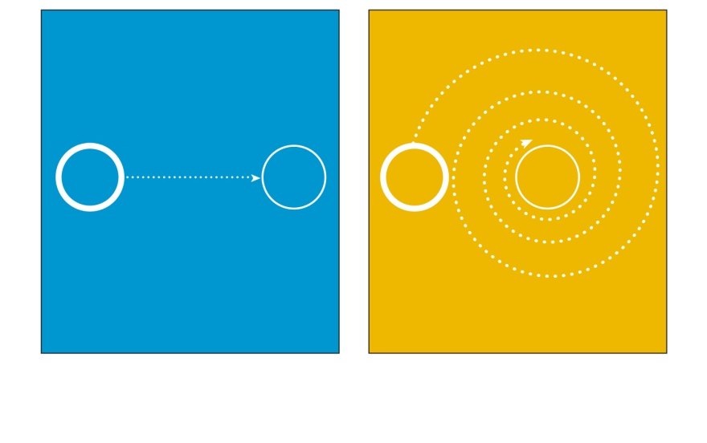
Key Dimensions of Culture
How do I make decision in uncertain or ambiguous situations?
Risk
Prefer rapid decision-making and quick results
Place great importance on flexibility and initiative
Value speed over thoroughness
Certainty
Spend significant time on background research
Establish proper procedures before starting a project
Value thoroughness over speed
Do not print – all dimensions together
How do I communicate requests, tasks, and feedback?
Direct
Come to the point quickly
Be forthright in asking questions in most settings
Be comfortable making requests, giving direction, or disagreeing with others
Give negative feedback directly
Indirect
Spend time explaining the context before coming to the point
Avoid asking questions in public settings
Express disagreement in subtle ways
Give negative feedback indirectly
Notes:
Do not print this page

Slide 34
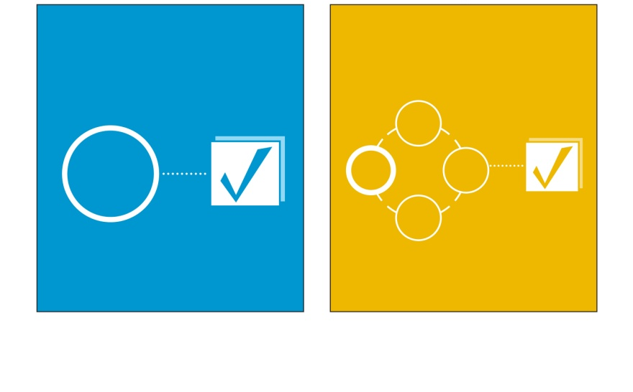
Key Dimensions of Culture
When working on new projects, do I prefer to address tasks first, or relationships first?
Task
Place high value on reaching goals and objectives on schedule
Prioritize accomplishing tasks over maintaining relationships
Focus on what people achieve more than who they know
Relationship
View time building relationships as key to achieving good results
Prioritize maintaining relationships over accomplishing tasks on time
Focus on who people know as much as what they themselves can achieve
Do not print – all dimensions together
Notes:
Do not print this page

